Slide 1
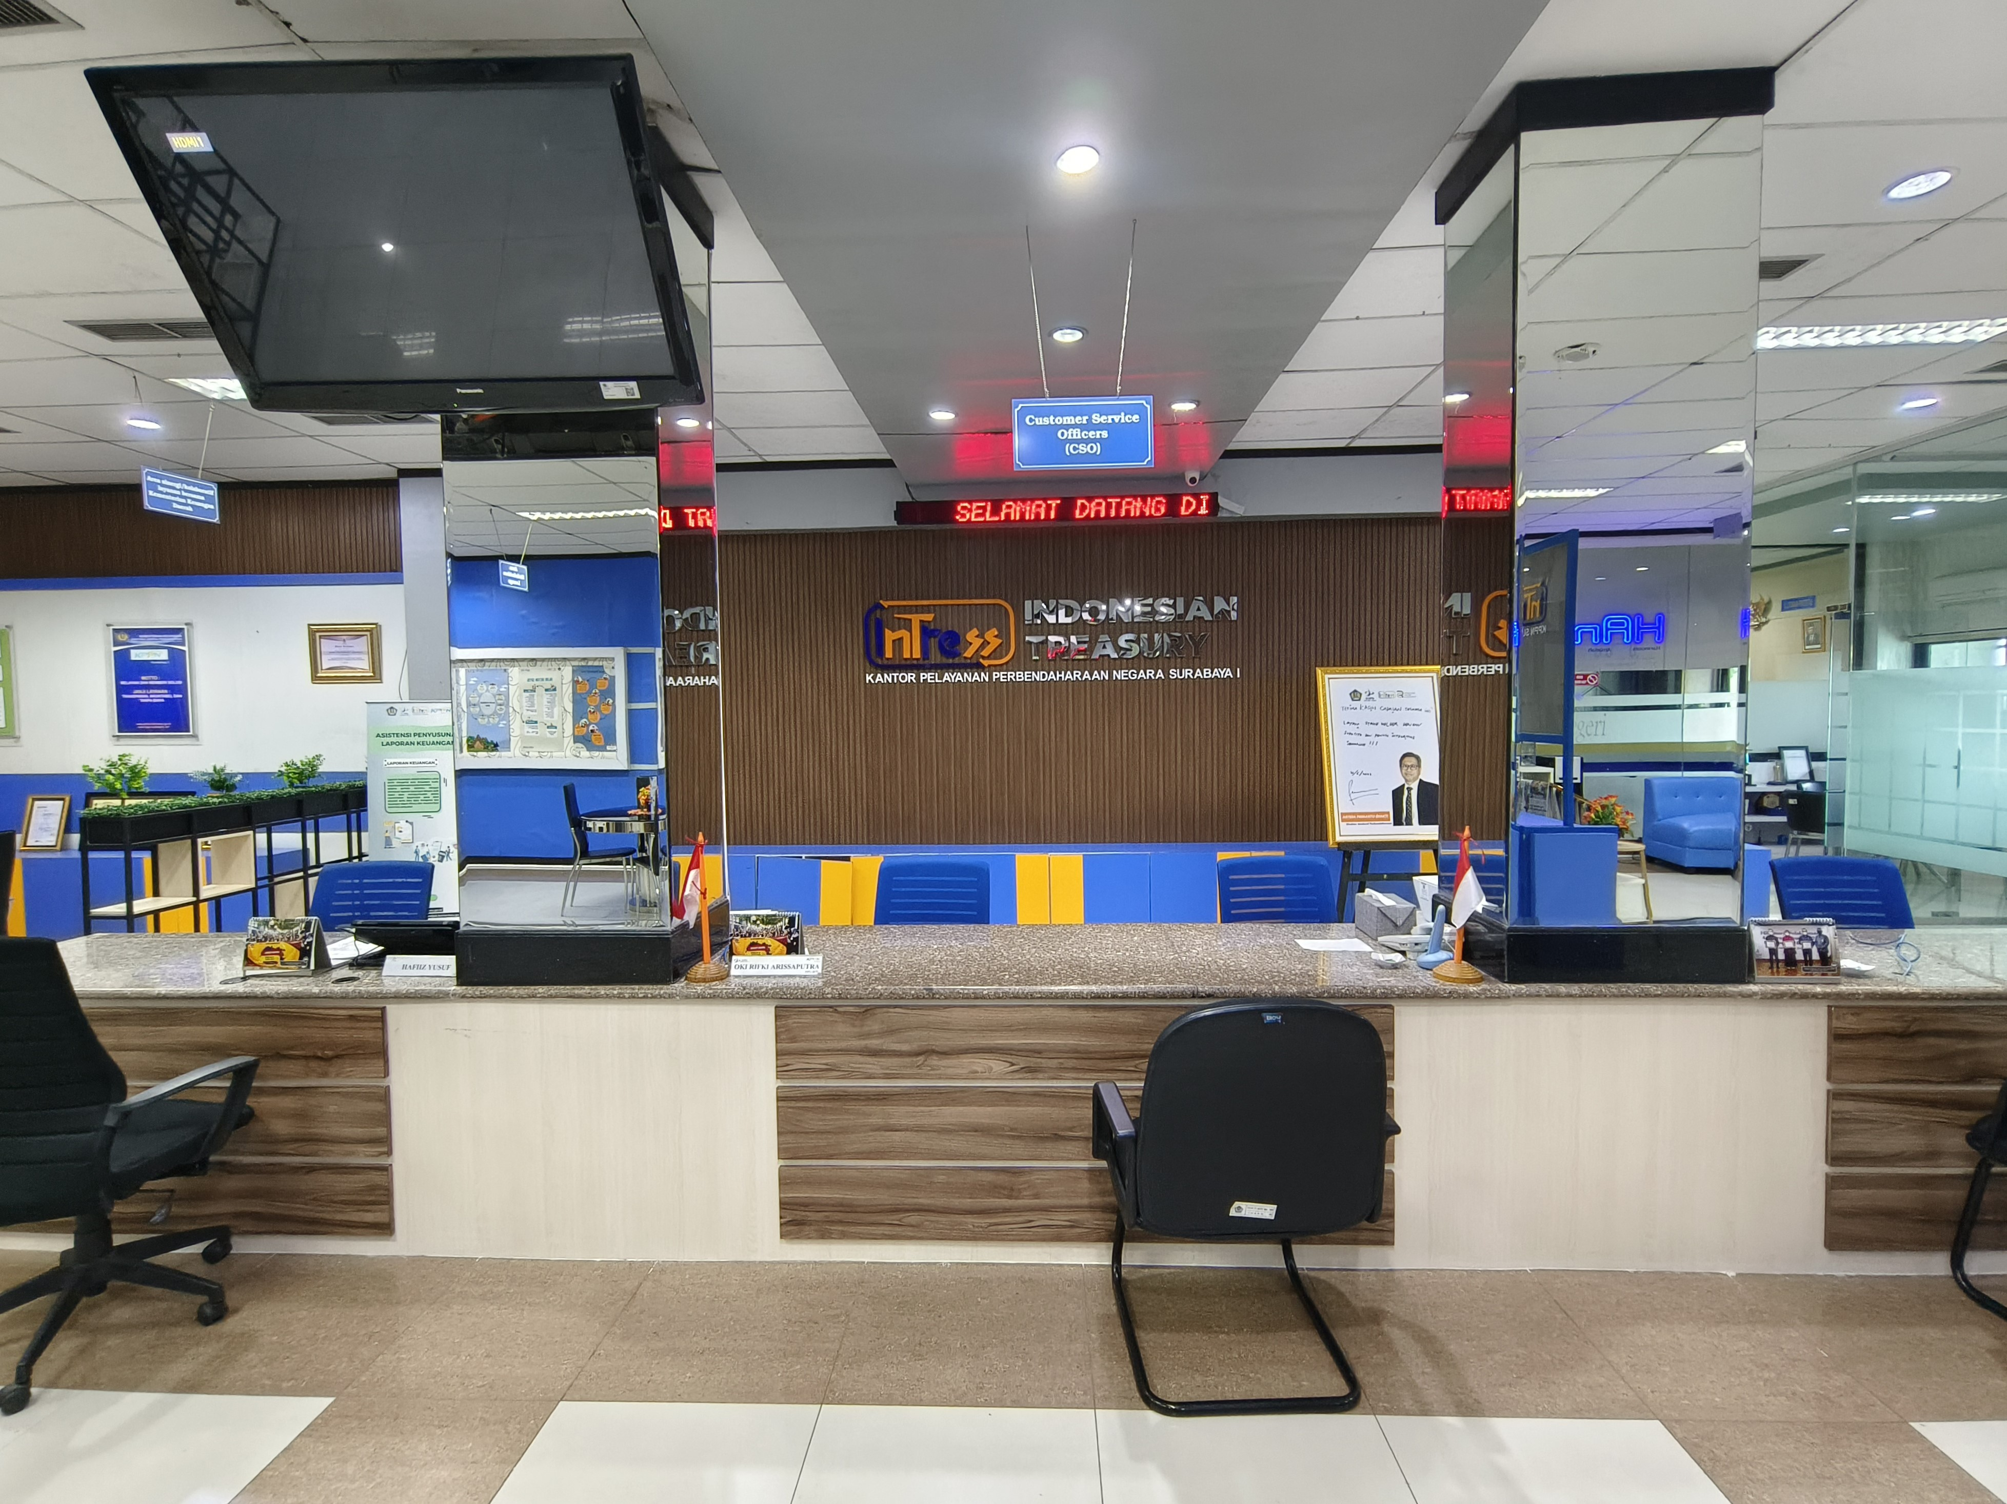

Data Analytics Project Proposal
Data Analitika Ekonomi Regional
Riki Akbar – Central Transformation Office
Riki Akbar – Central Transformation Office

Slide 2






Me in a Snapshot
Riwayat Pendidikan
Queen Mary University of London
2022
MSc Big Data Science
Telkom University
2012
S1 Teknik Informatika
Riki Akbar
Riwayat Pekerjaan
Data Analyst
Central Transformation Office
Central Transformation Office
2024
Direktorat Jenderal Pajak
2014-2023
Direktorat Teknologi Informasi Dan Komunikasi
2022-2023
Direktorat Data dan Informasi Perpajakan
2020-2021
Kantor Wilayah DJP Wajib Pajak Besar
2017-2020
Kantor Pengolahan Data Eksternal
2014-2017

Slide 3


Data Analytics
ways organizations manage data to support all its uses, and analyze data to improve decisions, business processes and outcomes, such as discovering new business risks, challenges and opportunities
the process and practice of analyzing data to answer questions, extract insights, and identify trends.

Slide 4
Data Analytics
Improve Decisions
Improve Business Processes
Answer Questions
Extract Insights
Identify Trends
Manage
Analyze
DATA

Slide 5
Data Analytics Types
Descriptive Analytics
examine, understand, and describe something that’s already happened.
Diagnostic Analytics
seeking to understand the why behind what happened
Predictive Analytics
answer questions about what will happen in the future
Prescriptive Analytics
identify specific actions that an individual or organization should take to reach future targets or goals
Example?
What's the Difference Between Data Analytics & Data Science? (hbs.edu)

Slide 6





Data Analytics: Why is it Important?
?
Business
Questions
Efficiency/
Optimization/
Automation
DA/DS Process as a Bridge
DA/DS Products
Solving Problems

Slide 7

Data Analytics: Why is it Important?
Iterative Subprocesses
Well-Documented
Accountable
Reproducible
DA/DS Process as a Bridge

Slide 8
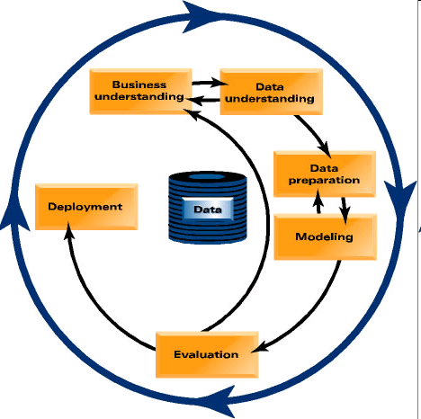
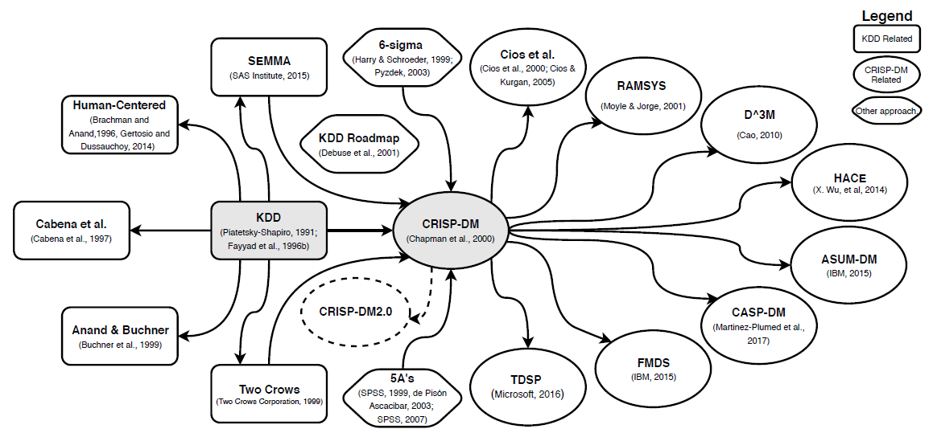
Data Analytics Life Cycle
CRoss Industry Standard Process for Data Mining

Slide 9


Data or Business First?
vs

Slide 10
Data or Business First?
Data-First Approach
Exploring previously hidden insight out of raw data with no specific goals in mind
Business-First Approach
Data exploration to answer specific business questions or to tackle specific business problems

Slide 11




Data Collection
Open Data
data.go.id
data.jakarta.go.id
opendata.jabarprov.go.id
data.acehprov.go.id
bps.go.id
data.worldbank.org
data.imf.org
data-apbn.kemenkeu.go.id
djpk.kemenkeu.go.id/portal/data/apbd
satudata.kemenkeu.go.id

Slide 12
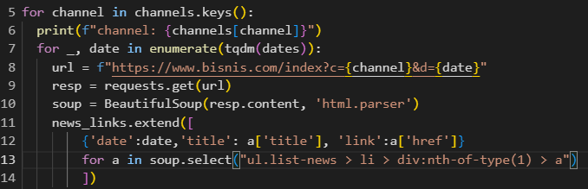
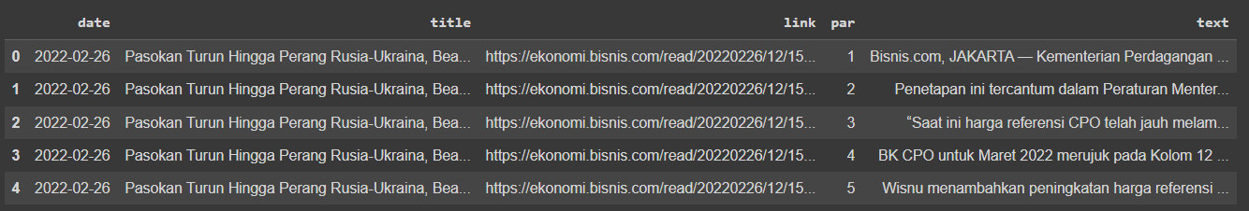
Data Collection
Scraping
!
Pay attention to Robots.txt

Slide 13
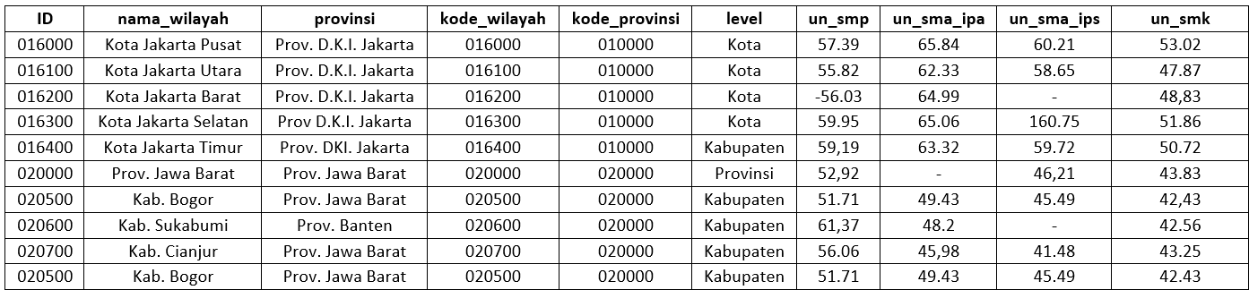
Data Preparation (cleansing)
Preprocess data to ensure it will be fit-for-analysis
Inconsistencies
Noisy records (or perhaps, outliers)
Missing values
Duplicates

Slide 14
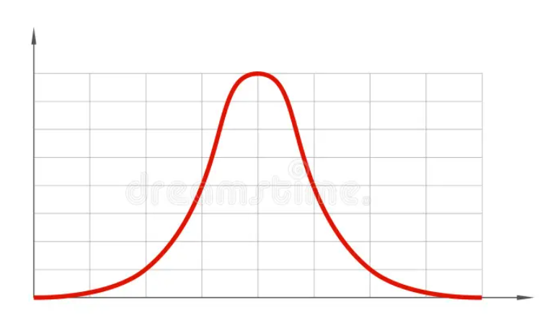
Exploratory Data Analysis
Data Distribution
Centrality
Mean, Median, Mode
Spread/Dispersion
Standard Deviation, Variance
standard-normal-distribution-vector-also-gaussian-bell-curve-206453093.jpg (800×800) (dreamstime.com)

Slide 15

Modelling
https://www.analyticsvidhya.com/blog/2021/07/how-to-choose-an-appropriate-ml-algorithm-data-science-projects/

Slide 16
Data Analytics Products
Dashboards
Presenting your findings through a visually compelling set of visualizations
Software-embedded Products
For predictive modelling, oftentimes the model is embedded within a software product
e.g.: Facial recognition in a clock-in-clock-out mobile apps
API (Application Programming Interface)
Granting access to your data/findings for wider audiences (or systems)

Slide 17
Visualization in a Nutshell
Know your Viz!
Bar chart
Comparing values for discrete categories
Line chart
Spotting trends over time
Pie Chart
Displaying proportions (best for less than 3 categories, otherwise don’t ever use it)
Scatter Plot
Spotting correlation between two numeric variables
Know further!
Substance over looks
Don’t let your viz becoming aimless. Information first, looks come second.
Remember the 3-seconds rule
Make sure your viz is easily digested and understood by your audience within 3 seconds

Slide 18
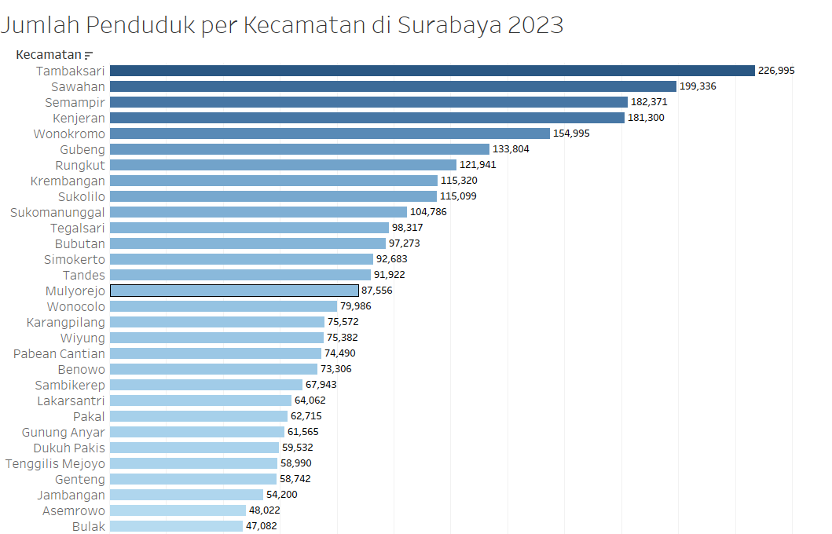
Visualization Examples

Slide 19
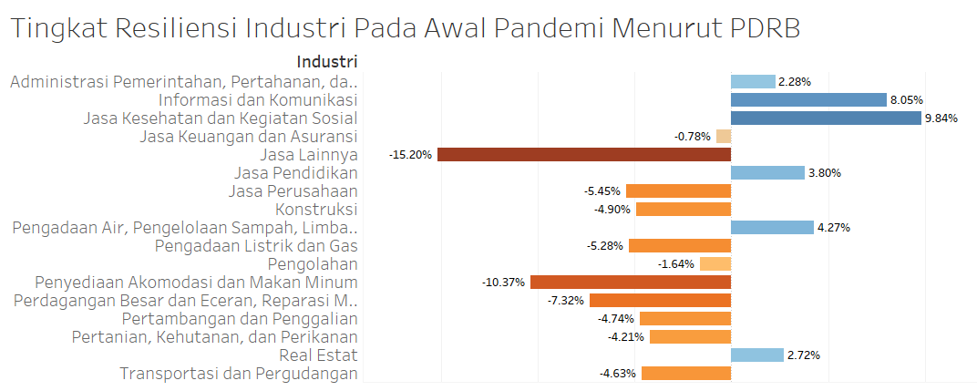
Visualization Examples
sumber: bps.go.id

Slide 20
Visualization Examples
sumber: bps.go.id

Slide 21
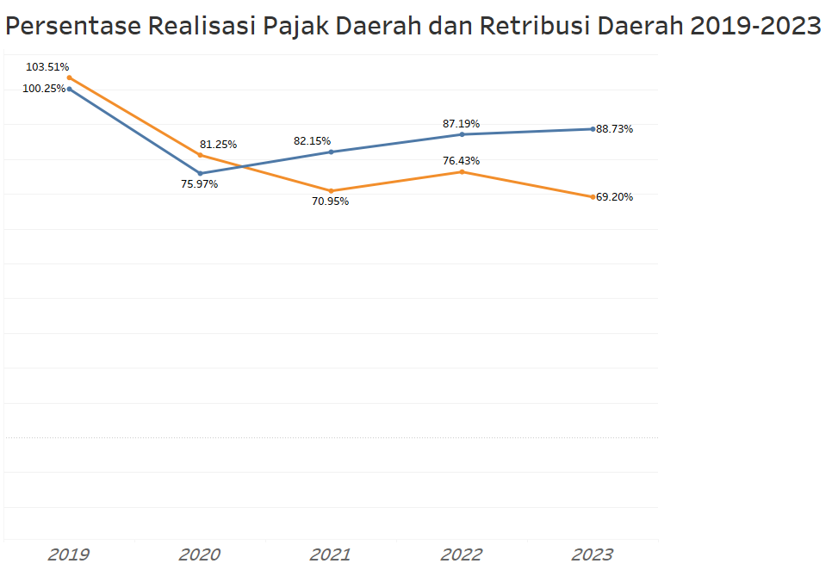
Visualization Examples
sumber: bps.go.id

Slide 22
Data Analytics Project Proposal
Thank you
Riki Akbar – Central Transformation Office

